Slide 1


Labs of Physics for Engineers
ACCELERATION DUE TO GRAVITY
Physics Experiment Teaching Center

Slide 2
Aim
To measure ‘g’, the acceleration due to gravity using a simple pendulum.

Slide 3
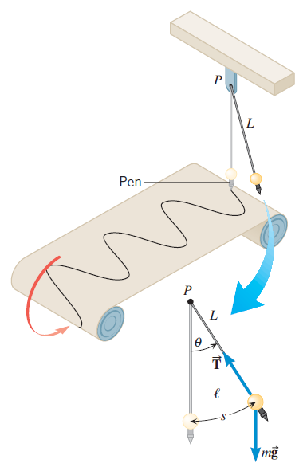
Theory
The motion of a simple pendulum is nearly simple harmonic. The periodic time T is related to the length L of the pendulum and the local acceleration due to gravity g.
or
If we measure the periodic time T for different lengths L, and plot T² versus L, we should get a straight line that passes through the origin. The graph will have slope . Thus, by measuring the slope of the graph we can determine g.

Slide 4
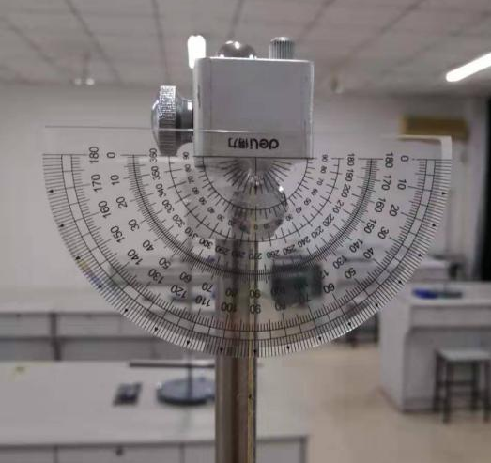
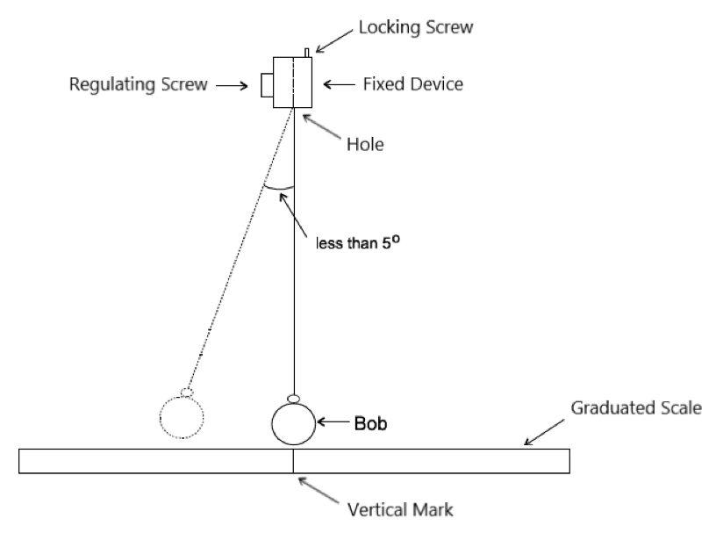
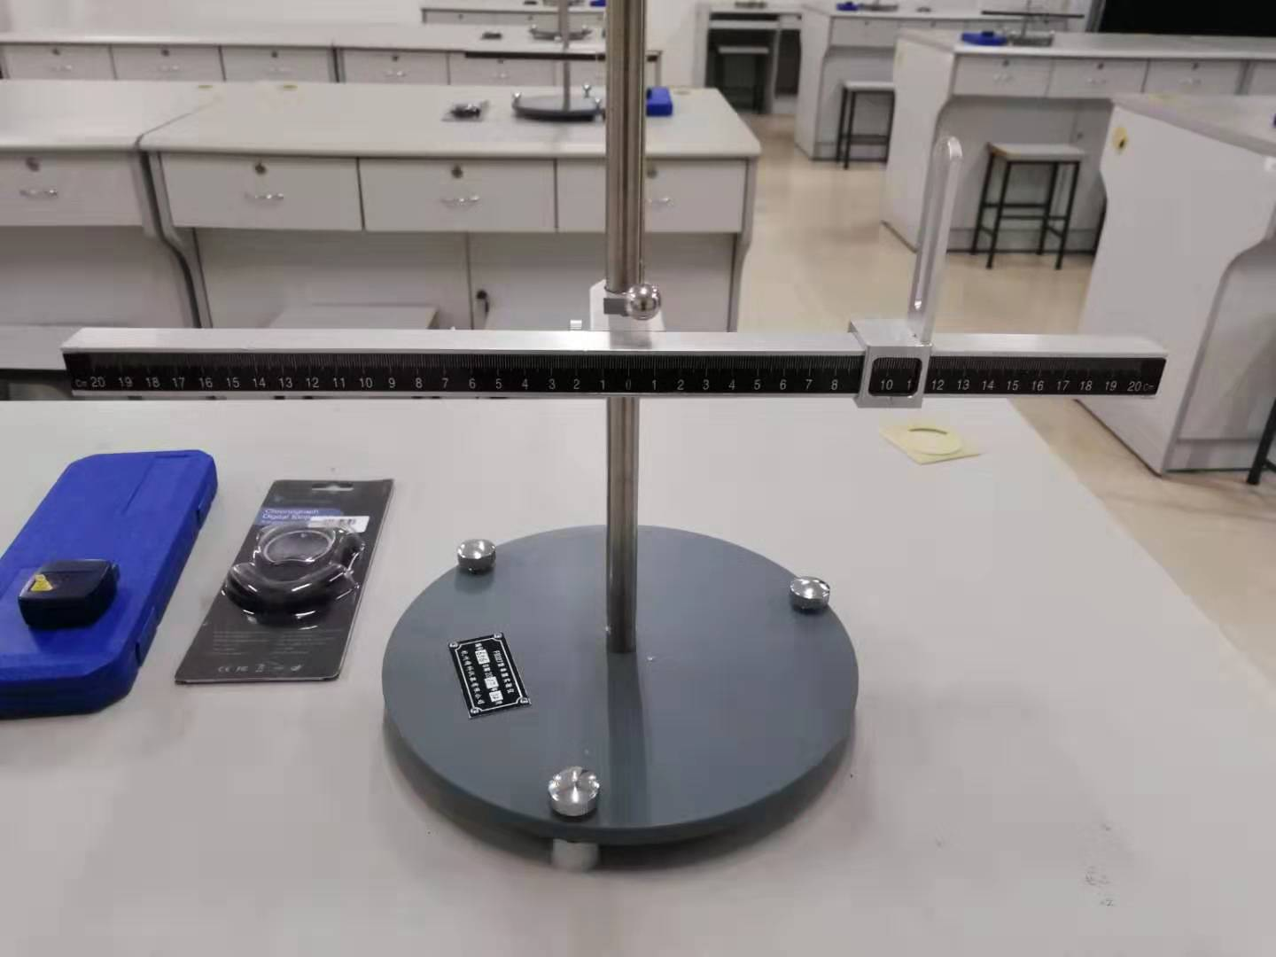
Apparatus

Slide 5
Procedure
1. Set the pendulum bob swinging through a small arc by using the large protractor as a guide. Check that the swing is in a vertical plane. Restart the bob if the swing is elliptical. A ‘small’ arc means less than 5○ or that the amplitude of swing is always less than one tenth of the length of the pendulum being used.
2. Choose five lengths (e.g. 0.45, 0.50, 0.55, 0.60 and 0.65 m are satisfactory). It is not necessary to adjust the lengths to those exact values. The length used should however be measured accurately - measure from the lower face of the hole of the fixed device to the centre of the bob.
3. For each length, make three determinations of the time required for 50 complete swings. Count ‘0’ as the bob passes the vertical marker and ‘1, 2, 3 etc.’ as the bob passes the marker again while going in the same direction. Average these three time values and calculate the time (periodic time) for one complete swing (oscillation).

Slide 6
Results
TABLE OF RESULTS
Radius R(mm) | Thread Length l (m) | Pendulum Length L (m) | Time for 50 Oscillations (s) |  |  |  | Periodic Time T (s) | T² (s²)
 |  |  | 1stRun | 2ndRun | 3rdRun | Average

Slide 7
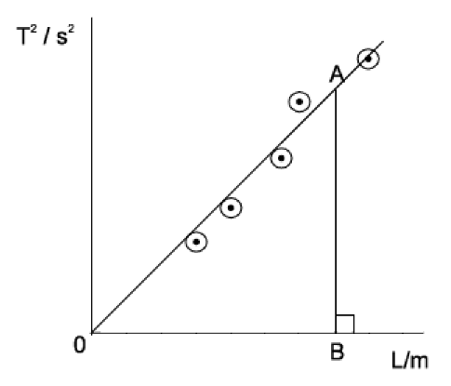
Results
Plot T² as a function of L. Obtain an average value of from the slope of the graph. When drawing the graph ensure that the points are evenly spread on both sides of the line.

Slide 8
Conclusions
1. The nominal value of g on a smooth Earth, taking into account oblateness and rotation is, at sea level :
Where ϕ is the latitude of the location. The latitude of FUZHOU UNIVERSITY is approximately 26.08○.
Use this information to calculate the value of g at FUZHOU UNIVERSITY, and compare this calculated figure with the value you have measured.
2. In no more than 100 words write a succinct summary of what you have done. State the goal and method of the experiment. State your main results, i.e.: What value did you get for the acceleration due to gravity? Is your result in agreement with the accepted value? If your result is not consistent with the accepted value can you suggest why not?

